Slide 1
Automated Lip Reading
By Dung Le
Full Stack Mobile Artificial Intelligence

Slide 2
Problem
Automated Lip Reading (Audio Visual Recognition)
Assist people with hearing impair; Improve speech recognition tasks, especially in the noisy environment or disrupted audio file.
Very challenging, due to the variances in input (skin color, mouth shape, accent, speed, etc.) and the one-to-many relationship between viseme and phoneme.

Slide 3
Advantages
Most of the work done relied on either Hidden Markov Model (HMM) or neural network model (CNN and RNN)
Chung et al. (2016) proposed using dual attention mechanism in addition to LSTMs
My proposed method utilises reinforcement learning technique - the agent, i.e. my network model, learned the lip reading features by interacting with the environment (sequence of images extracted from close-up video) and maximize the reward achieved by predicting the correct word at any time step.

Slide 4
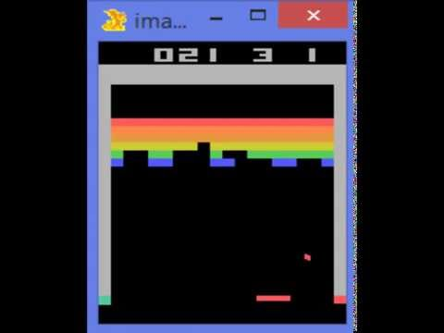
Deep Q-Learning
In 2015, DeepMind published a paper “Human-level control through deep reinforcement learning” in Nature.
Playing classic game Atari Breakout by observing and maximize the reward through different actions.
Test on six other games, 3 of them surpassed human player.

Slide 5
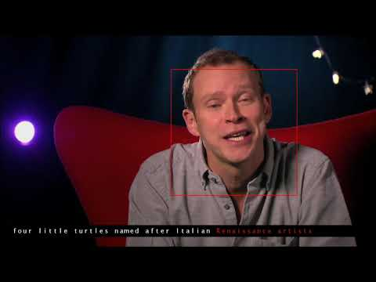
BBC-Oxford Dataset

